Slide 1
Debugging
By Jessica Garson

Slide 2
Who am I?
I’m a software developer at Burson-Marsteller
Python is my language of choice
Can be followed on twitter at @JessicaGarson
I teach programming classes around town
https://github.com/jessicagarson
Planning the Tech Lady Hackathon – October 22nd
Co-organizer of Hack&&Tell DC
I have a zine called What’s my Function that’s available for download on my github

Slide 3
Let’s get to know each other
Name
Background
Project you are working on
Favorite movie

Slide 4
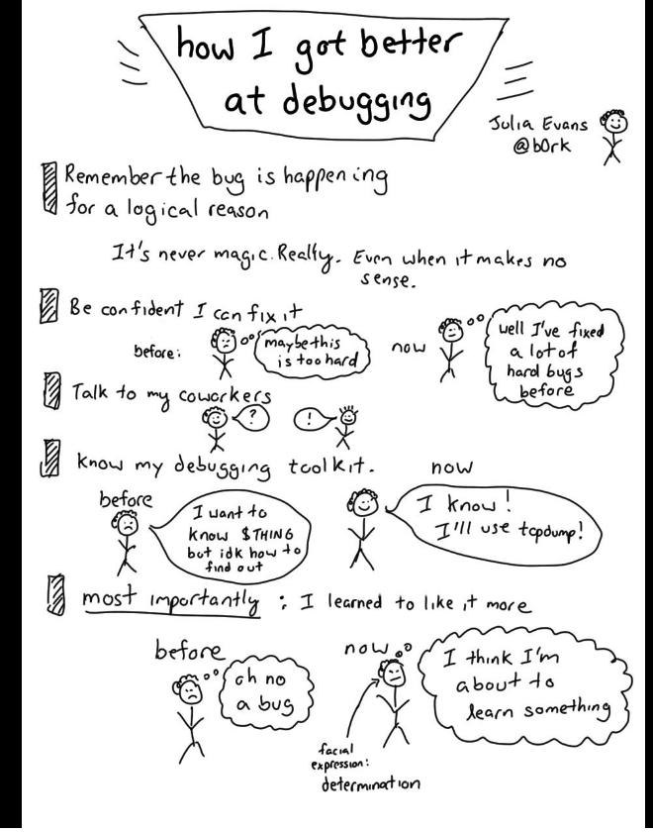
How I learned to be good at debugging by Julia Evans

Slide 5

Don’t take it personally – this is really hard for me

Slide 6
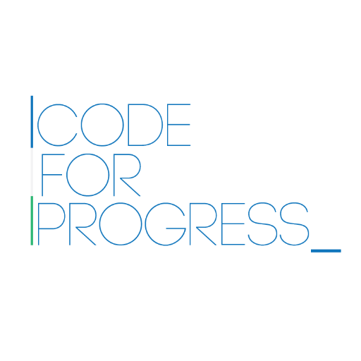





Find your community

Slide 7
Google is a good first place to go
Sometimes, you can find out the answer to the problem just by googling a problem
Even the best programmers google often
Keep in mind there are some problems that can’t resolved this way

Slide 8
Stack Overflow and Documentation are the second place to go
Stack Overflow is great
Documentation varies in quality depending on the language or library you are using

Slide 9
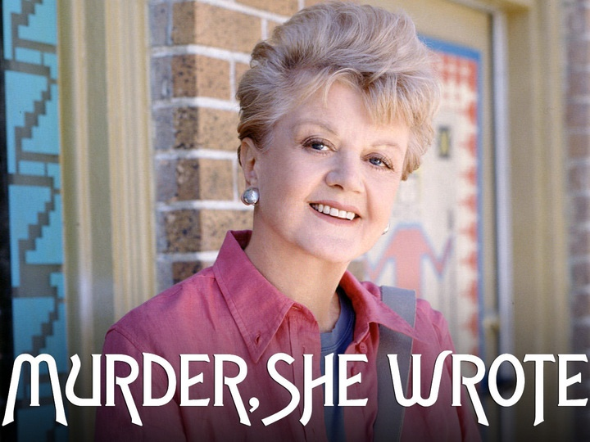
Think of yourself as detective trying to solve a mystery

Slide 10

Programming is creating a very specific set of instructions for your computer to follow

Slide 11
Finding bugs is solving puzzles
Most of my bugs are silly – like spelling errors or forgetting to indent a level or things like that
I like to think of it as solving a puzzle

Slide 12
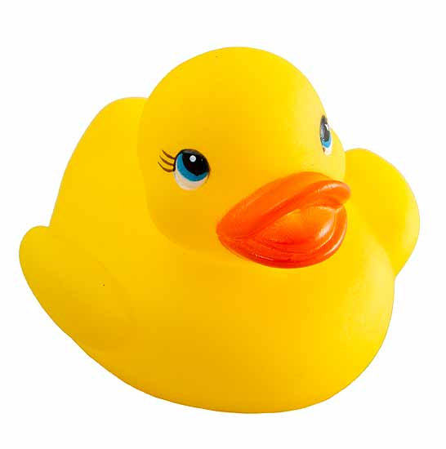
Rubber Duck Method

Slide 13
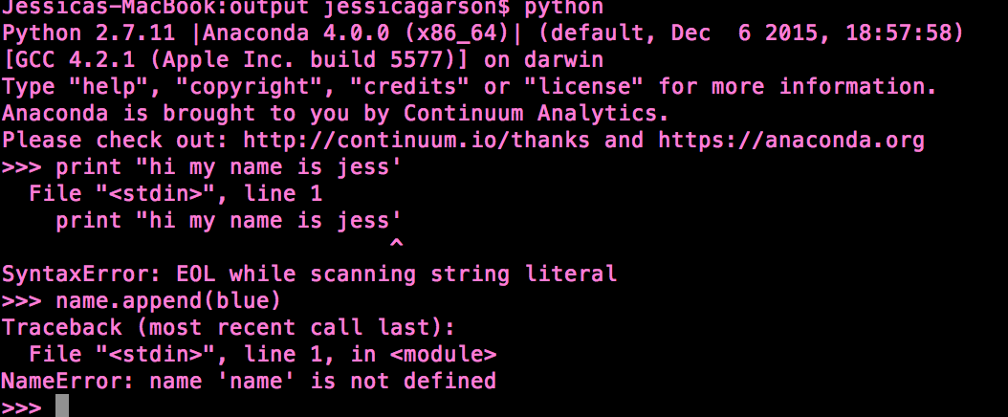
Let’s make some mistakes together

Slide 14
Your text editor is your BFF
A good editor alerts you to issues as you are going
I use a combination of PyCharm, Atom, and Sublime Text

Slide 15
Using tests in your code is key
Testing allows you to find problems with your code before you can
I use pytest
Unit testing and nose tests are also options for python
When looking for work make sure you ask about the culture of testing

Slide 16
When in doubt, refactor your code
Make it as simple as possible and look for the easiest possible option
Common tricks I use:
Making lines as short as possible
Breaking up lines that do multiple things into their own line of code

Slide 17
Read a book on the problem
Sometimes you need to acquire a deeper understanding of the problem you are working on
There is no shame in reading a book two to learn more about the problem you are facing

Slide 18
Part of the growing process
The best developers encounter bugs daily
One year my New Year’s resolutions one year was to get lots of syntax errors

Slide 19
Keep in touch
jessica.garson@gmail.com

